Slide 1
FFT and DCT in Image Processing
Fourier Technique for image processing project GUI

Slide 2
OutLine
Introduction
JPEG Compression with Quality Factor using Discrete Cosine Transform
JPEG Compression with ZigZag Algorithm using Discrete Cosine Transform
Add Noise to Image
Denoise noisy image using Discrete Fourier Transform (Fast Fourier Transform)
Denoise noisy image using Adaptive Filters
Conclusion

Slide 3
OutLine
Introduction
JPEG Compression with Quality Factor using Discrete Cosine Transform
JPEG Compression with ZigZag Algorithm using Discrete Cosine Transform
Add Noise to Image
Denoise noisy image using Discrete Fourier Transform (Fast Fourier Transform)
Denoise noisy image using Adaptive Filters
Conclusion

Slide 4
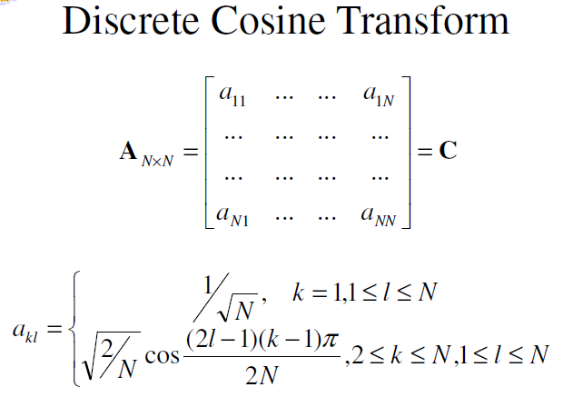
JPEG Compression using quantization
this is where the big compression occurs
this is also what makes JPEG lossy
this is the step controlled by the “quality factor”
different coefficients for luminance and chrominance channels

Slide 5
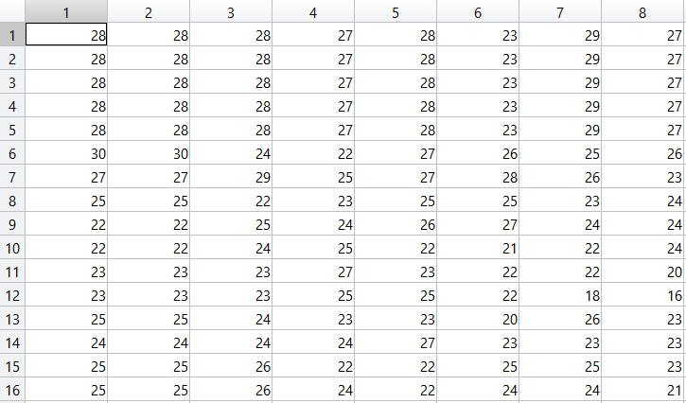
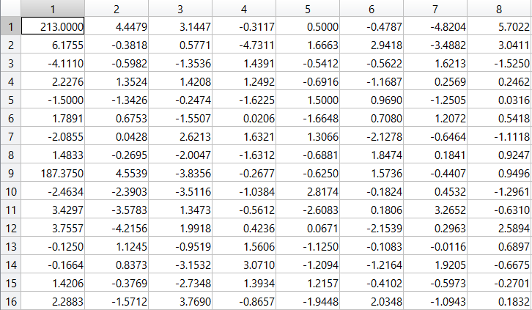
What does DCT do for the image?
Image Raw Data
DCT for 8X8 blocks

Slide 6
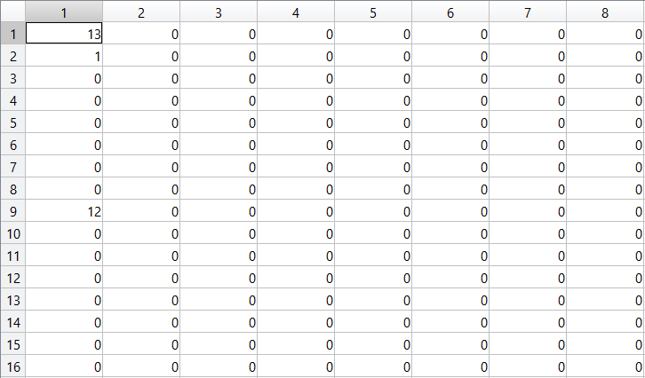
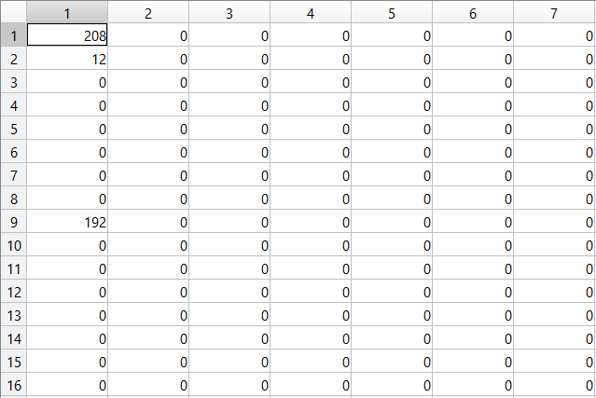
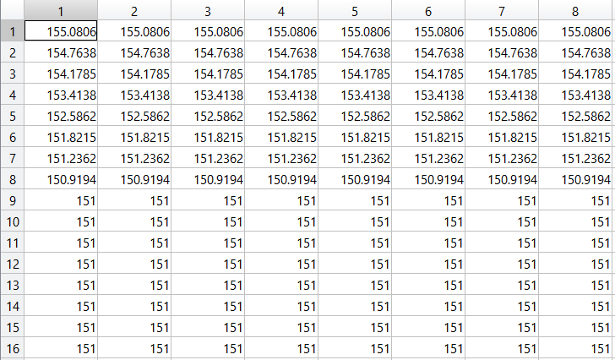
Quantization

Slide 7
Quantization
qfun = @(block_struct) round(block_struct.data/q);
XQ = blockproc(img_DCT,[bs bs],qfun);
[XQBitStream, ~] = ImageEncode(XQ);
XQBitRate = length(XQBitStream)/prod(size(XQ));
dqfun = @(block_struct) round(block_struct.data*q);
XQ = blockproc(XQ,[bs bs],dqfun);

Slide 8
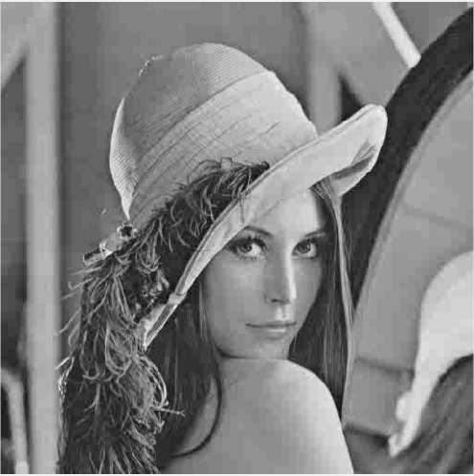

Reconstruct image with different quality factor
Block Size = 8 ; Quality Factor = 40
Block Size = 8 ; Quality Factor = 80

Slide 9
Demonstration for JPEG Compression with Quality Factor
Fourier Technique for image processing project GUI

Slide 10
OutLine
Introduction
JPEG Compression with Quality Factor using Discrete Cosine Transform
JPEG Compression with ZigZag Algorithm using Discrete Cosine Transform
Add Noise to Image
Denoise noisy image using Discrete Fourier Transform (Fast Fourier Transform)
Denoise noisy image using Adaptive Filters
Conclusion

Slide 11
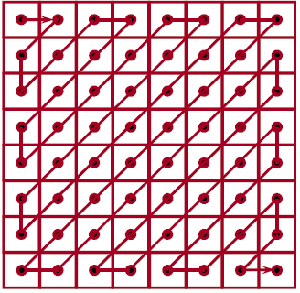
JPEG Compression using Zig-Zag Algorithm
Scan-order of each 8 × 8 block of pixels for DCT to form a 1D string of integer labels
zzfun = @(block_struct)
ZigZagscan(block_struct.data,col);
zz_img = blockproc(dct_img,[bs bs],zzfun);

Slide 12
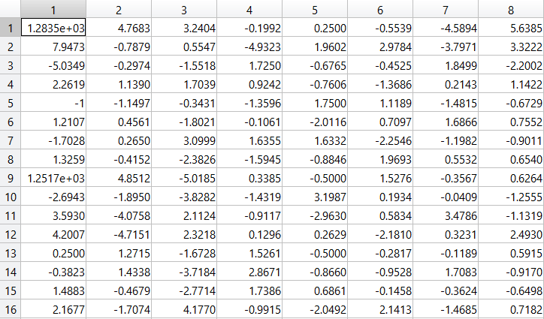
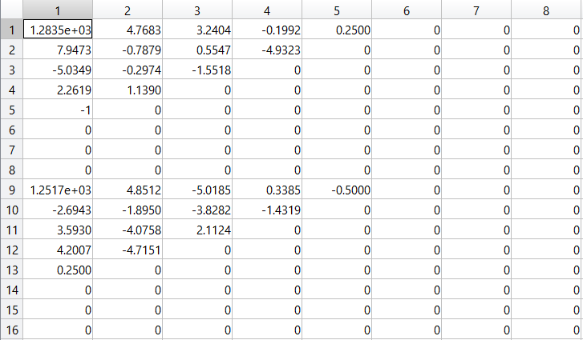
What does ZIG-zag scan to the image?
Before Zig-Zag
Zig-Zag Scan and Zero out the rest

Slide 13


Reconstruct image with different zig-zag coefficient
Block Size = 8 ; ZigZag Coefficient = 3
Block Size = 8 ; ZigZag Coefficient = 15

Slide 14
Demonstration for JPEG Compression with Quality Factor
Fourier Technique for image processing project GUI

Slide 15
OutLine
Introduction
JPEG Compression with Quality Factor using Discrete Cosine Transform
JPEG Compression with ZigZag Algorithm using Discrete Cosine Transform
Add Noise to Image
Denoise noisy image using Discrete Fourier Transform (Fast Fourier Transform)
Denoise noisy image using Adaptive Filters
Conclusion

Slide 16
Add Noise to Image
Value | Description
'gaussian' | Gaussian white noise with constant mean and variance
'poisson' | Poisson noise
'salt & pepper' | On and off pixels
'speckle' | Multiplicative noise
img_Gaussian = imnoise(img,'gaussian'); %(c)
img_Poisson = imnoise(img,'poisson'); %(d)
img_SaleAndPepper = imnoise(img,'salt & pepper'); %(e)
img_Speckle = imnoise(img,'speckle'); %(f)

Slide 17
Demonstration for adding noise to images
Fourier Technique for image processing project GUI

Slide 18
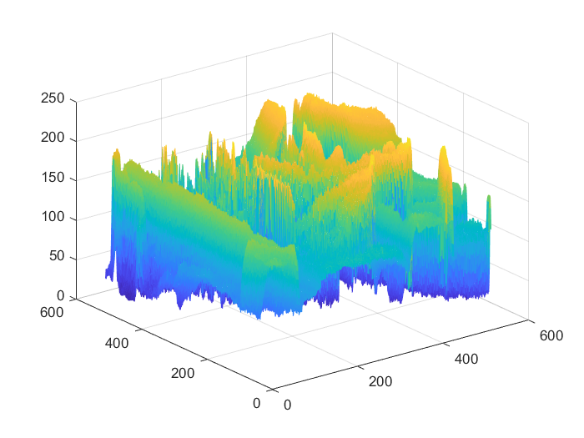
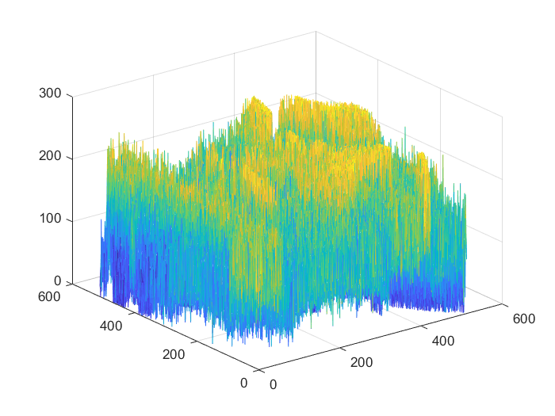
What does DFT do for image
Lena.tif
Lena.tif with Gaussian Noise

Slide 19
OutLine
Introduction
JPEG Compression with Quality Factor using Discrete Cosine Transform
JPEG Compression with ZigZag Algorithm using Discrete Cosine Transform
Add Noise to Image
Denoise noisy image using Discrete Fourier Transform (Fast Fourier Transform)
Denoise noisy image using Adaptive Filters
Conclusion

Slide 20
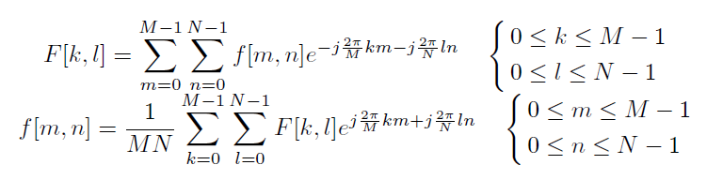
DFT, IDFT and FFT
FFT algorithms are just computational schemes for computing the DFT

Slide 21
How Fourier transform process image in frequency domain
% Fourier transform
fftimg = fft2(douimg); % Take Fourier Transform 2D
fftshiftimg = 20*log(abs(fftshift(fftimg))); % Shift center; get log magnitude
% Application of low pass filter in reconstruction
%Image dimensions
[row,col] = size(douimg); %[height, width]
%Sampling intervals
dx = 1;
dy = 1;
%Characteristic wavelengths
KX = (mod(1/2 + (0:(col-1))/col, 1) - 1/2) * (2*pi/dx);
KY = (mod(1/2 + (0:(row-1))/row, 1) - 1/2) * (2*pi/dy);
[KX,KY] = meshgrid(KX,KY);
%Filter formulation
lpf = (KX.*KX + KY.*KY < cutoff^2);
%Filter Application
rec = ifft2(lpf.*fftimg);

Slide 22
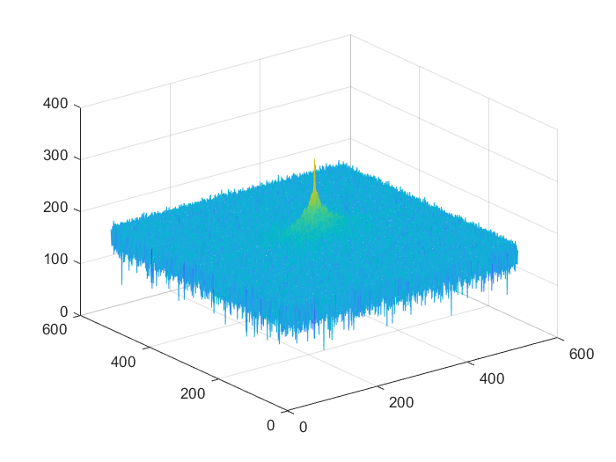
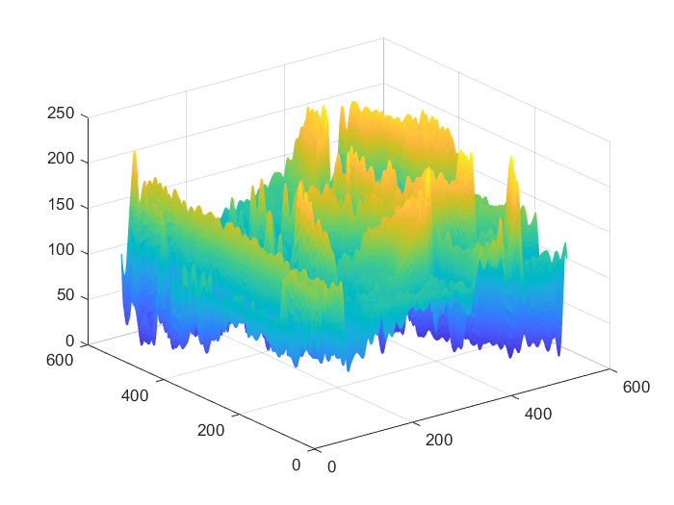
What does IDFT does for image
Hand-Made FFT2 Filter
IDCT Lena.tif with Gaussian Noise

Slide 23
Demonstration for Denoise noisy image using Discrete Fourier Transform
Fourier Technique for image processing project GUI

Slide 24
OutLine
Introduction
JPEG Compression with Quality Factor using Discrete Cosine Transform
JPEG Compression with ZigZag Algorithm using Discrete Cosine Transform
Add Noise to Image
Denoise noisy image using Discrete Fourier Transform (Fast Fourier Transform)
Denoise noisy image using Adaptive Filters
Conclusion

Slide 25
Denoise noisy image using Adaptive Filters
h = fspecial('average',hsize)
h = fspecial('disk',radius)
h = fspecial('gaussian',hsize,sigma)
h = fspecial('laplacian',alpha)
h = fspecial('log',hsize,sigma)
h = fspecial('motion',len,theta)
h = fspecial('prewitt')
h = fspecial('sobel')

Slide 26
Demonstration for Denoise noisy image using Adaptive Filters
Fourier Technique for image processing project GUI

Slide 27
OutLine
Introduction
JPEG Compression with Quality Factor using Discrete Cosine Transform
JPEG Compression with ZigZag Algorithm using Discrete Cosine Transform
Add Noise to Image
Denoise noisy image using Discrete Fourier Transform (Fast Fourier Transform)
Denoise noisy image using Adaptive Filters
Conclusion

